Slide 1


Recent Advances in AI for Weather Forecasting
WorldLearningAlgeria, Apr 2025
Dr. Redouane Lguensat ^{1,2}
¹ Institut Pierre Simon-Laplace (IPSL), Sorbonne Université
² IRD (French National Research Institute for Sustainable Development)

Slide 2
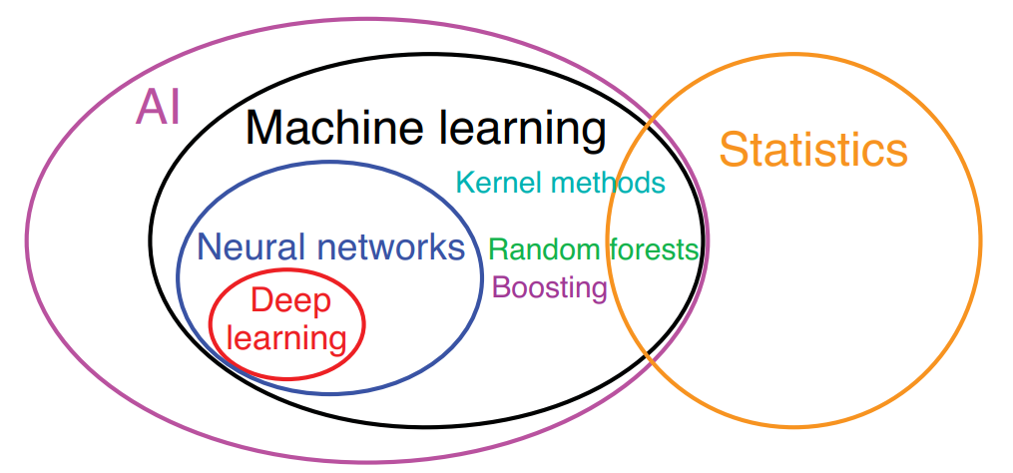
Part I
Some definitions
Notes:
Hsieh et al. 2022

Slide 3


Machine Learning
IPSL
FAQ
Subdomain of Artificial Intelligence (AI), ML is not new ! long history but using different names
The recent revolution was driven by a subdomain of ML: Deep Learning (DL) + the advancements in computational/storage capacities
Deep Learning techniques use a ML algorithm called Neural Networks (NN)
Nowadays ML applications are ubiquitous in our daily lives. Recommendation systems, text translation, image recognition, etc..
“a data scientist looking at climate simulations” by the DALL.E ML model of OpenAI

Slide 4

Data Scientist
IPSL
What is expected from you?
Understand business or research problems and define what needs to be solved.
Collect & Clean Data – Gather data from multiple sources and ensure it’s usable (a lot of time goes here!).
Analyze & Explore – Use statistics and visualizations to find trends, patterns, and insights.
Build Models – Apply machine learning and other algorithms to make predictions or classify data.
Communicate Insights – Create dashboards, reports, or visual stories to explain findings clearly.
“a data scientist” by the DALL.E ML model of OpenAI

Slide 5
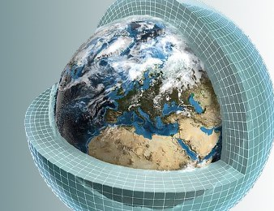
DKRZ
Part II
“Short” Overview of ML problems
Notes:
why

Slide 6
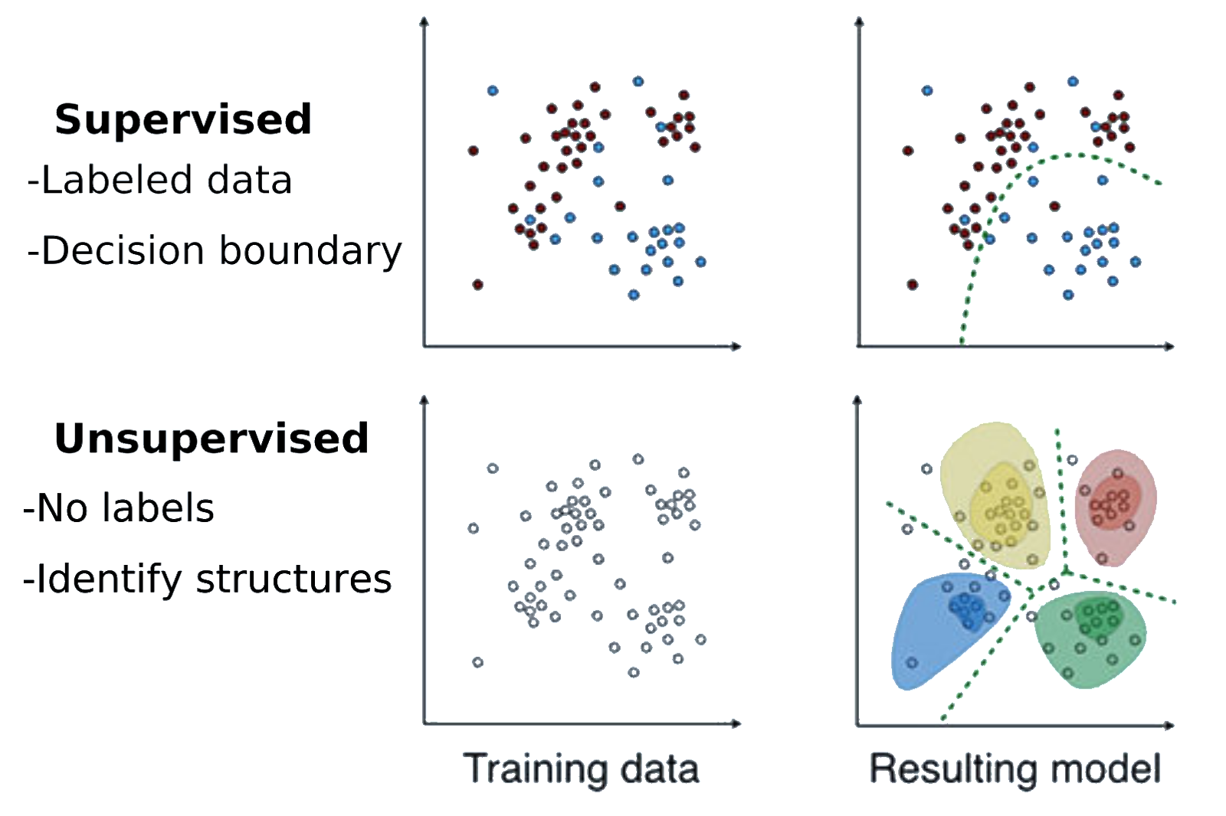
Clustering / Classification
IPSL
quick introduction
Langs et al., 2018

Slide 7
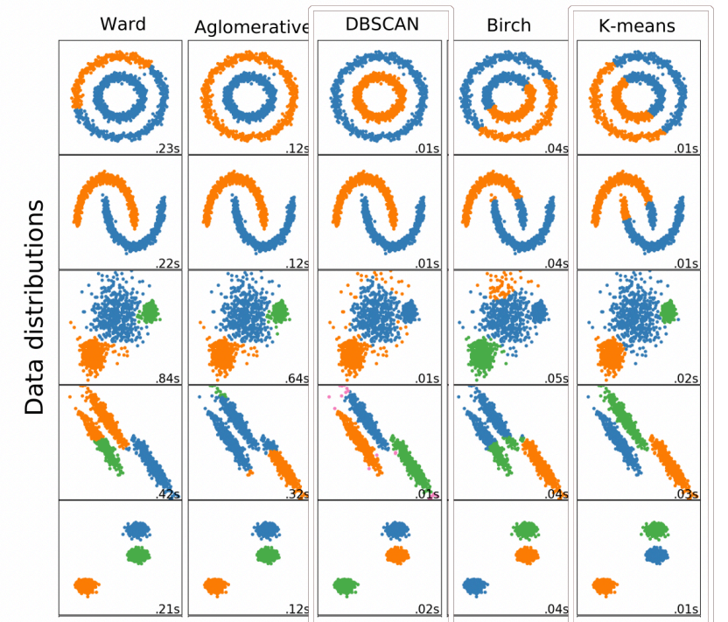
Clustering techniques
IPSL
some examples

Slide 8
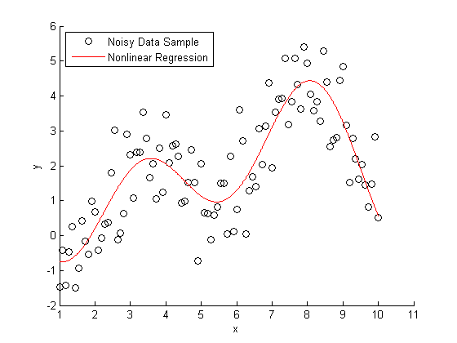
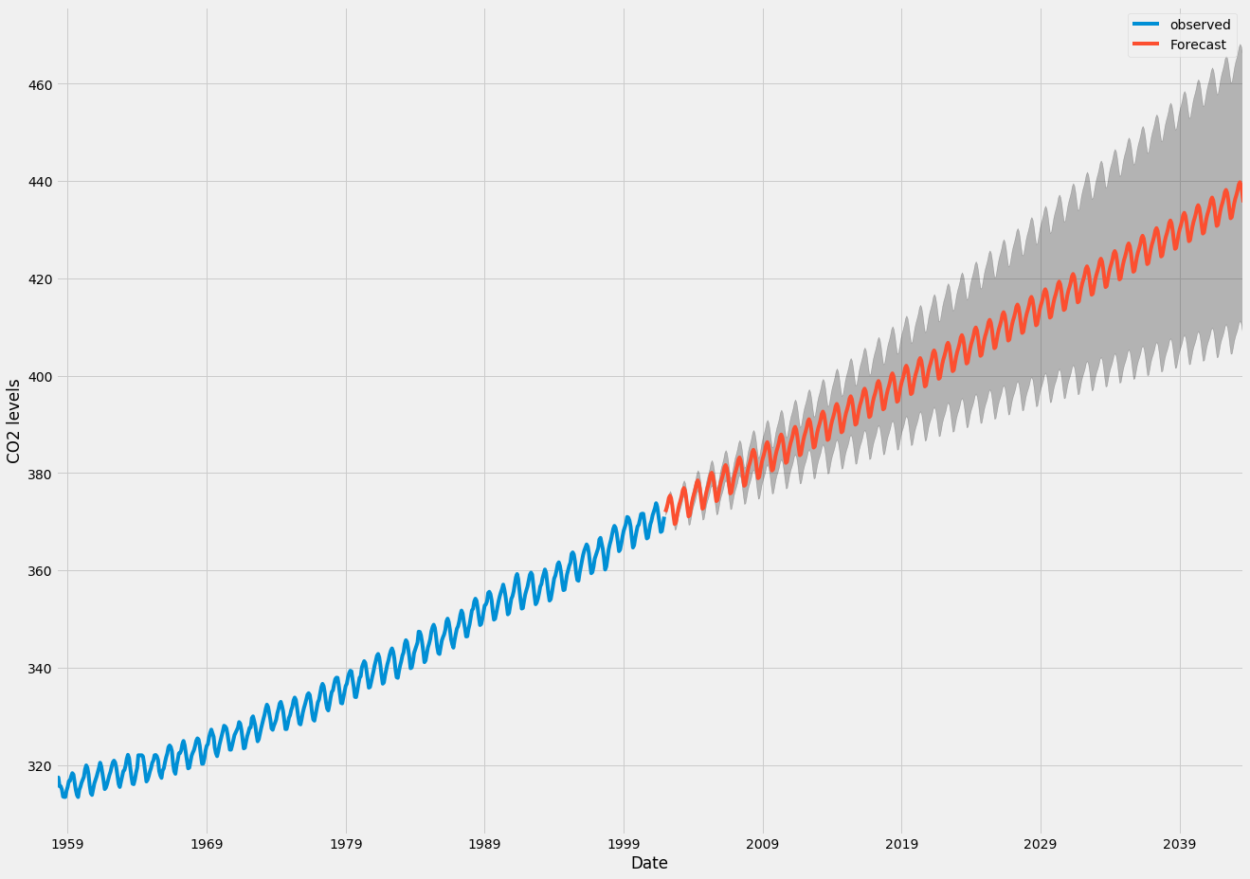
Regression
IPSL
quick intro

Slide 9
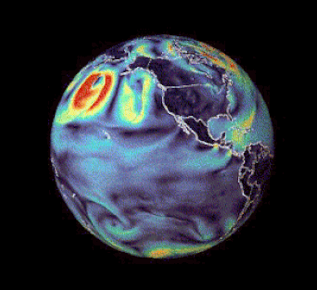
Part III
A revolution is happening in ML for Weather !
Notes:
Hsieh et al. 2022

Slide 10
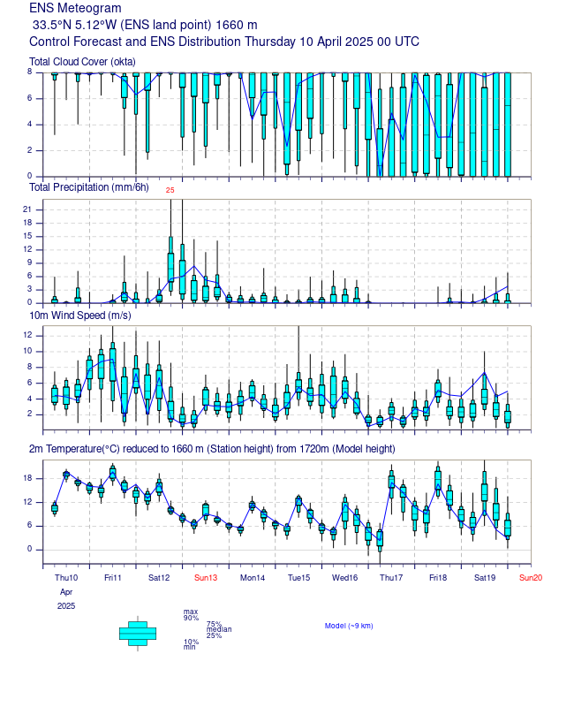
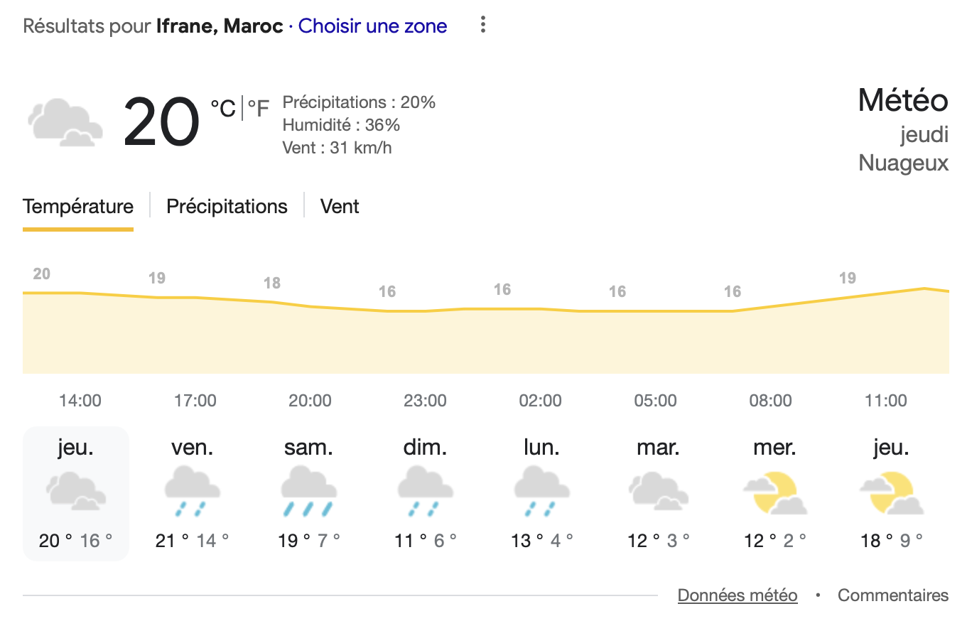
Weather Forecasting
IPSL
Intro
Credit: ECMWF

Slide 11
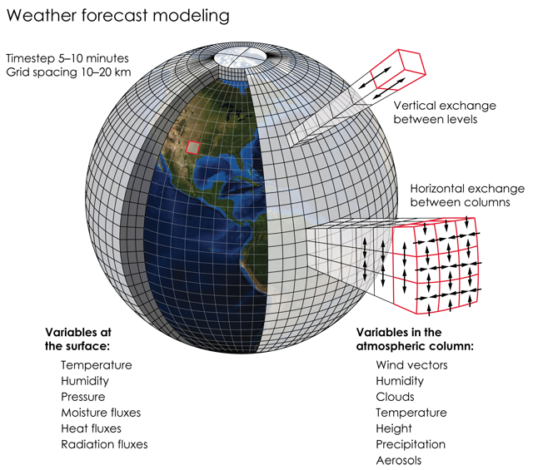
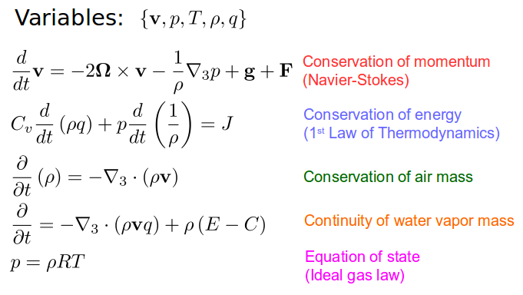
Numerical Weather Prediction systems
IPSL
Traditional approach
https://blogs.reading.ac.uk/weather-and-climate-at-reading/2018/the-size-of-the-nwpda-problem/
Credit: K. Cantner, AGI.

Slide 12

Numerical Weather Prediction systems
IPSL
Traditional approach
🏆 ECMWF’s Integrated Forecasting System (IFS)
HRES
ENS
single 10-day forecast 0.1° resolution
several times per day
ensemble model set of 50 stochastically perturbed 15-day forecasts 0.1° resolution several times per day
Goal of ML-based WF: beat HRES and ENS

Slide 13
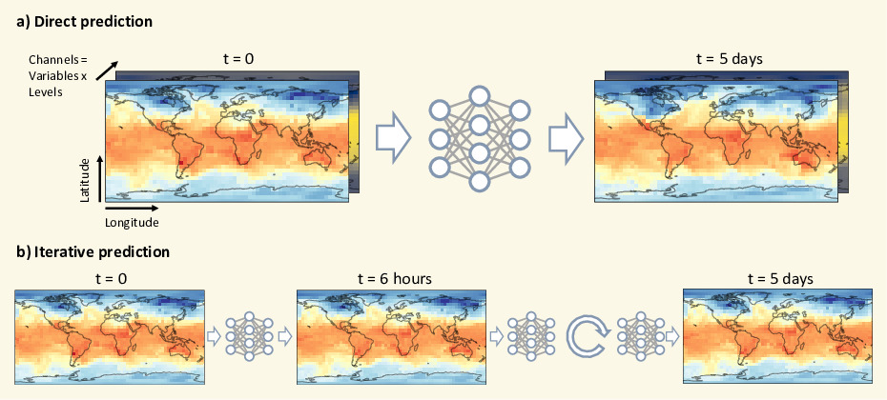
ML-based weather forecasting
IPSL
short story
https://raspstephan.github.io/blog/weatherbench/

Slide 14
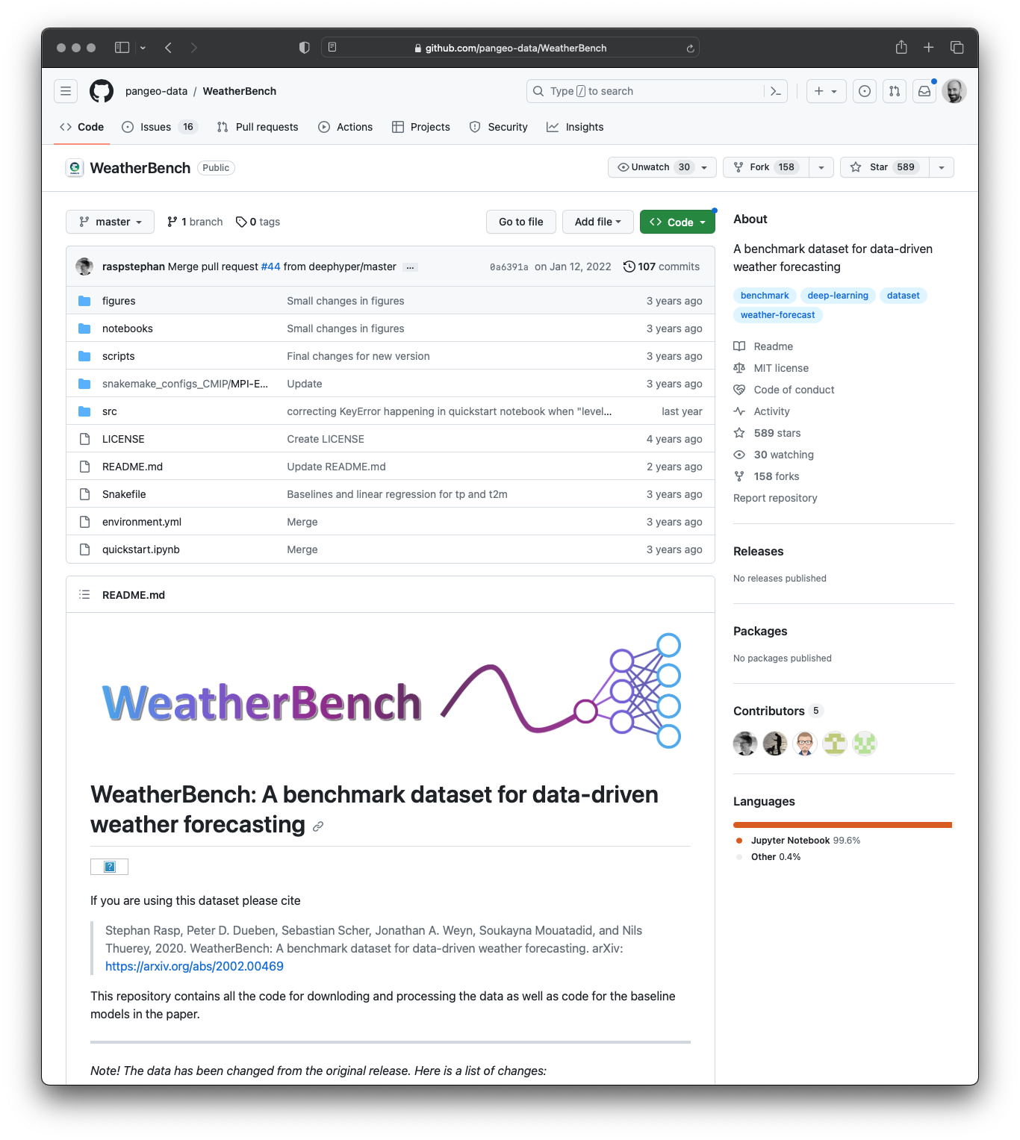
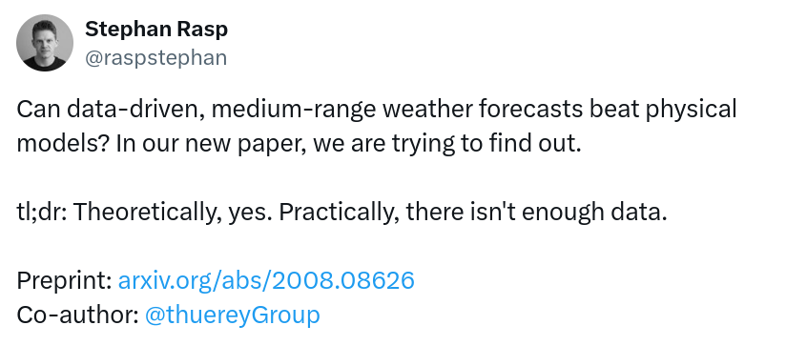
ML-based weather forecasting
IPSL
Back in 2020: challenges and skepticism
https://github.com/pangeo-data/WeatherBench

Slide 15
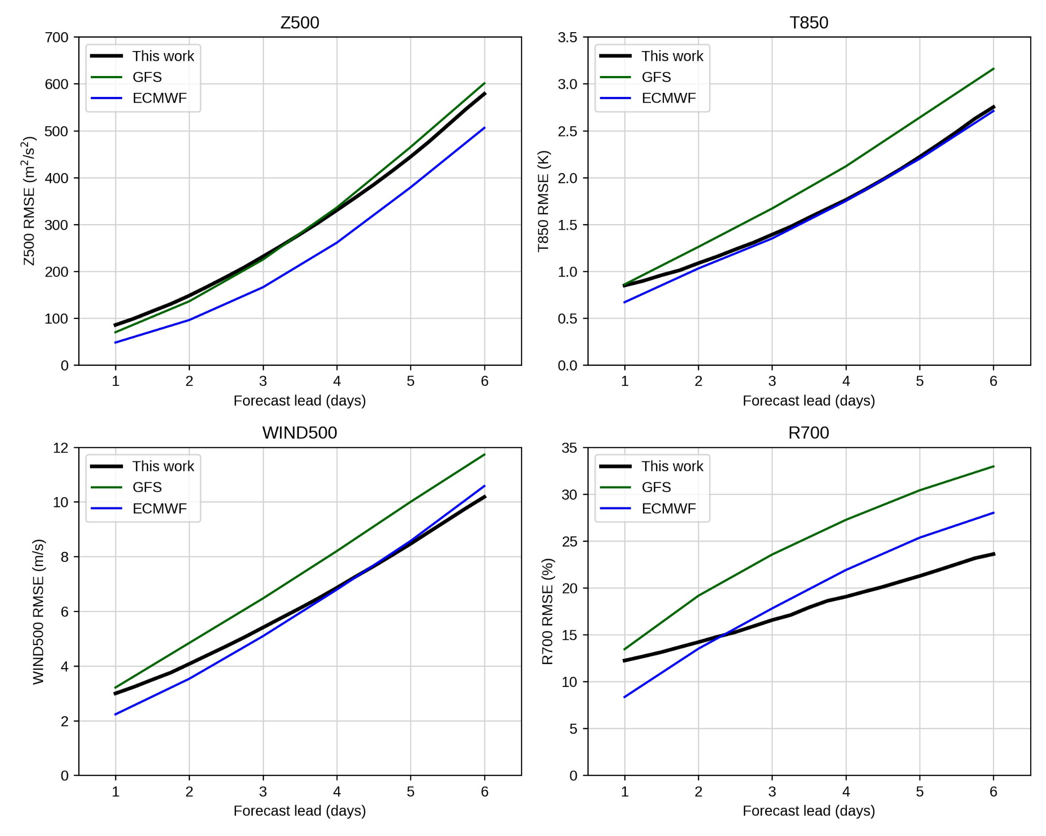
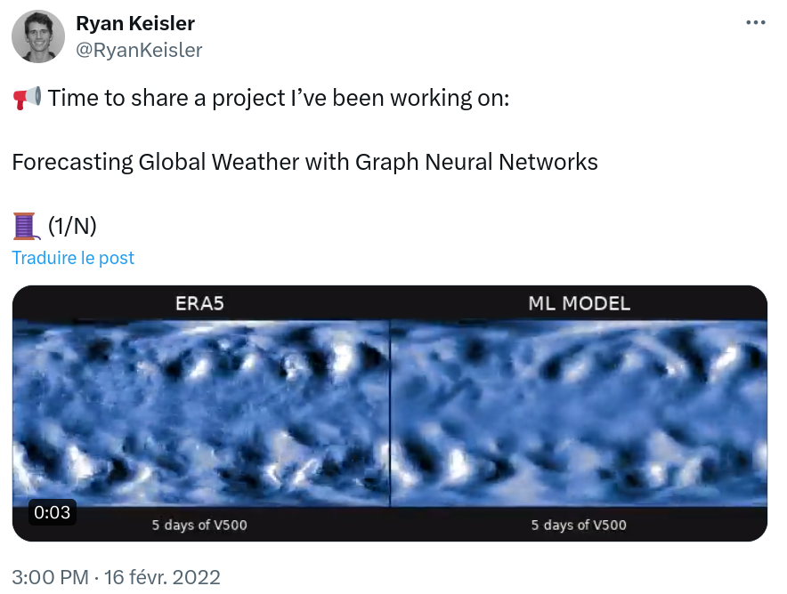
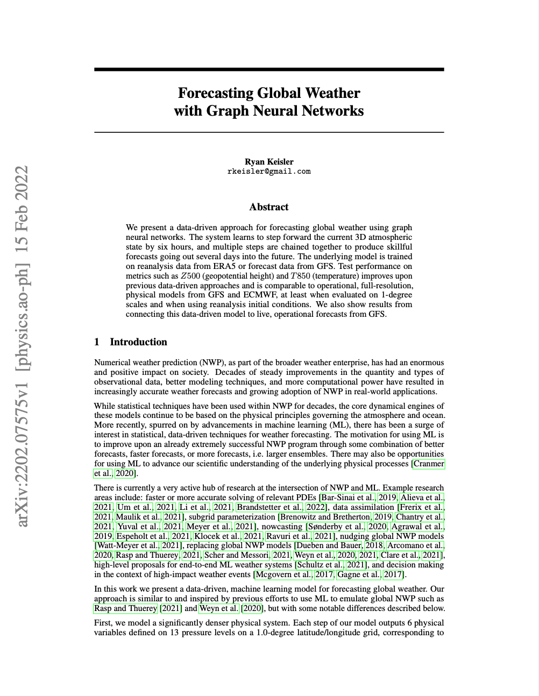
ML-based weather forecasting
IPSL
2022: the year of the breakthroughs
Keisler et al. (2022)
https://doi.org/10.48550/arXiv.2202.07575

Slide 16
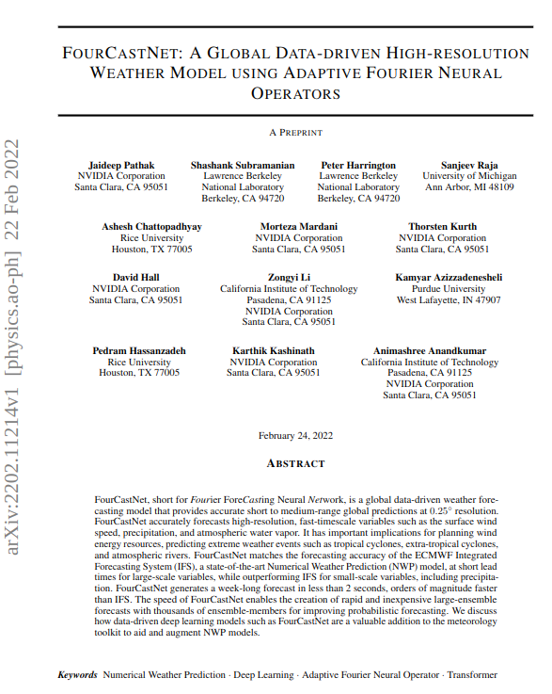
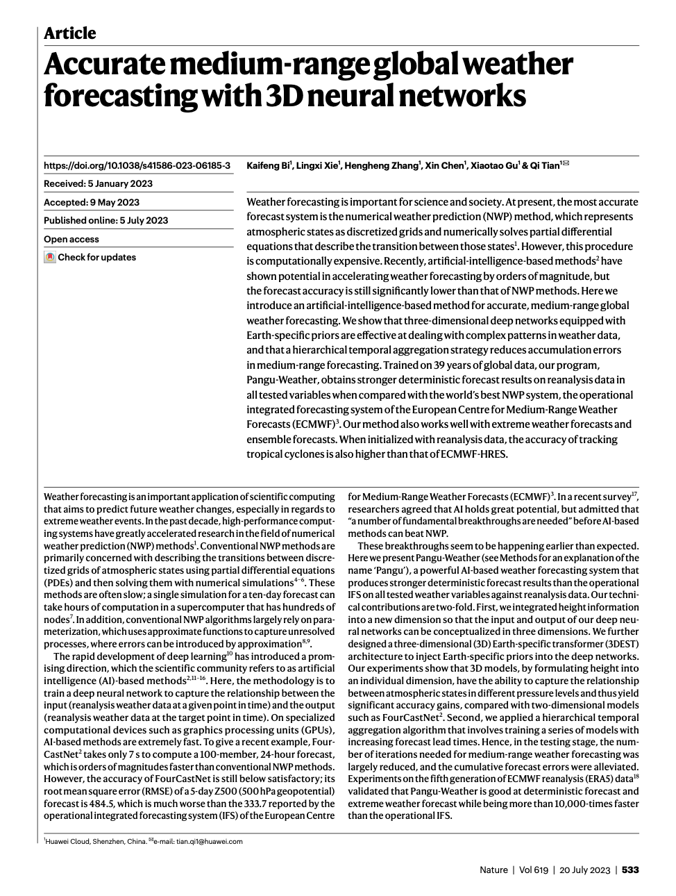
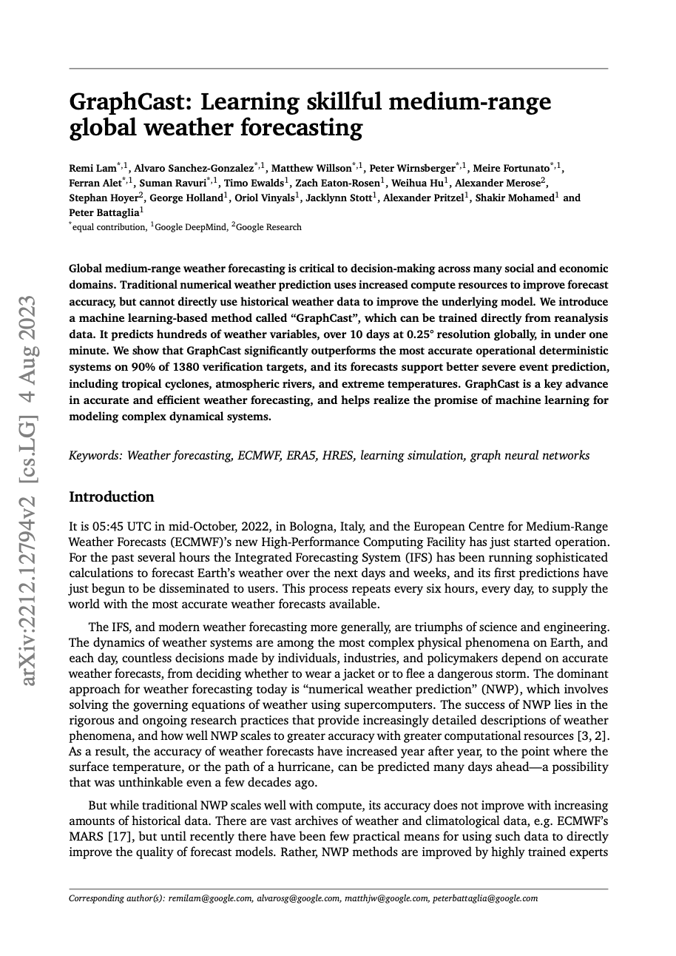
ML-based weather forecasting
IPSL
2022: the year of the breakthroughs
FourCastNet
(Nvidia)
PanguWeather (Huawei)
GraphCast
(Google DeepMind)
https://arxiv.org/pdf/2202.11214
https://doi.org/10.1038/s41586-023-06185-3
https://doi.org/10.48550/arXiv.2212.12794

Slide 17
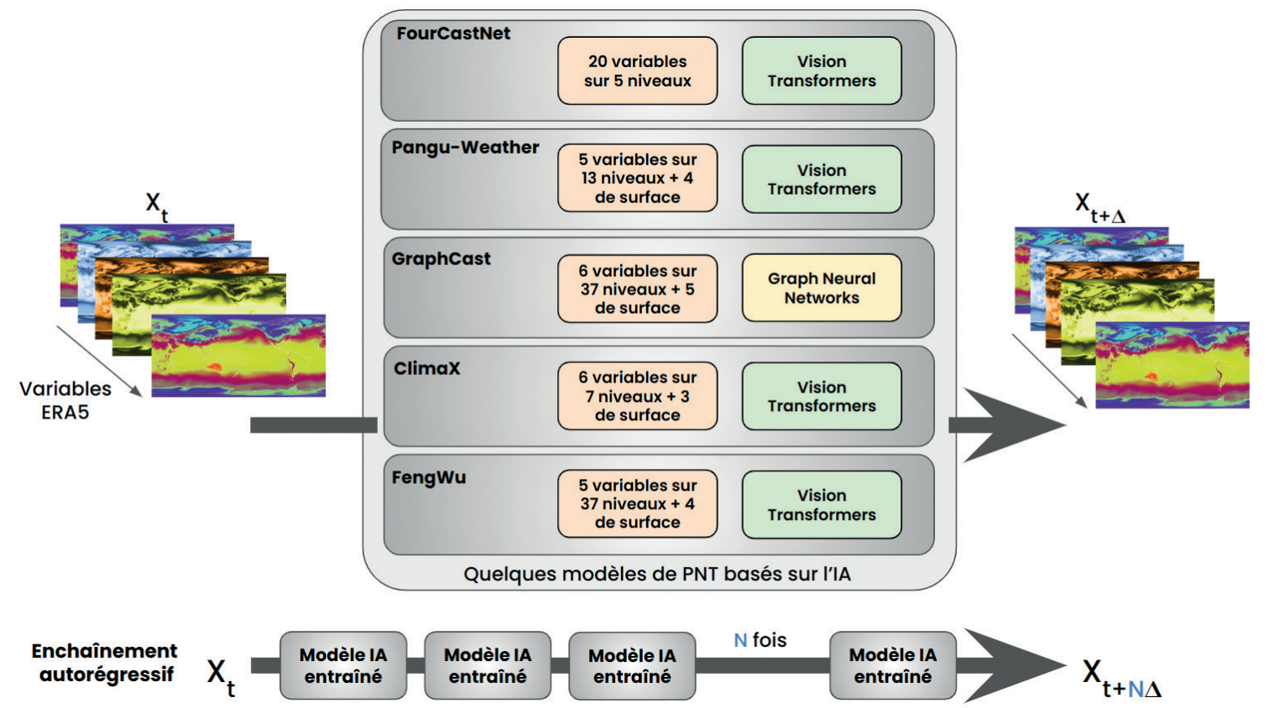
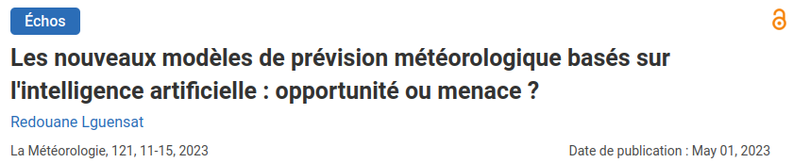
ML-based weather forecasting
IPSL
Mid-2023
Lguensat 2023, La météorologie

Slide 18
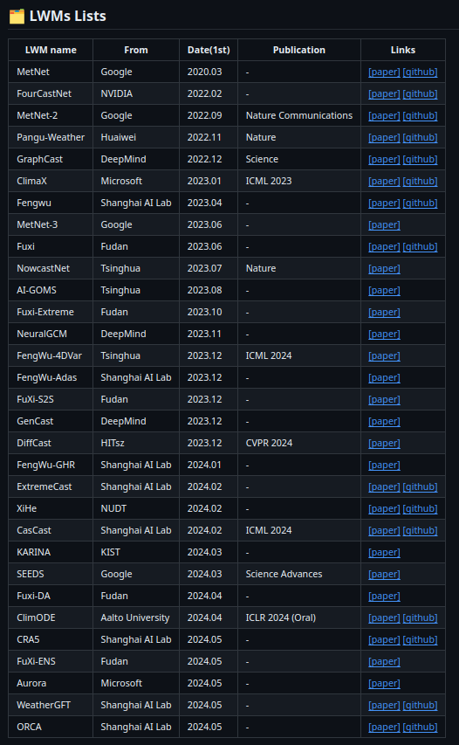
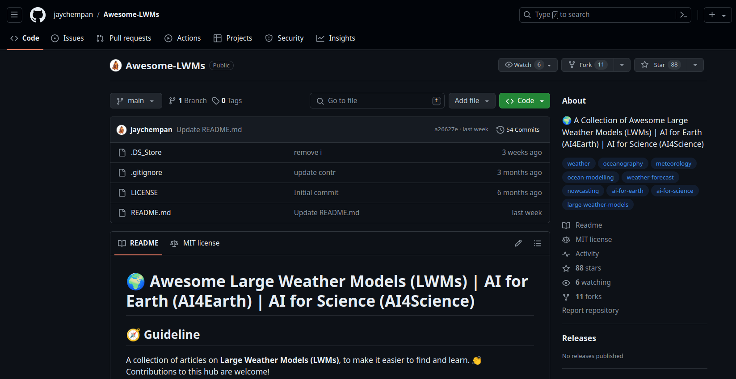
ML-based weather forecasting
IPSL
Now…

Slide 19
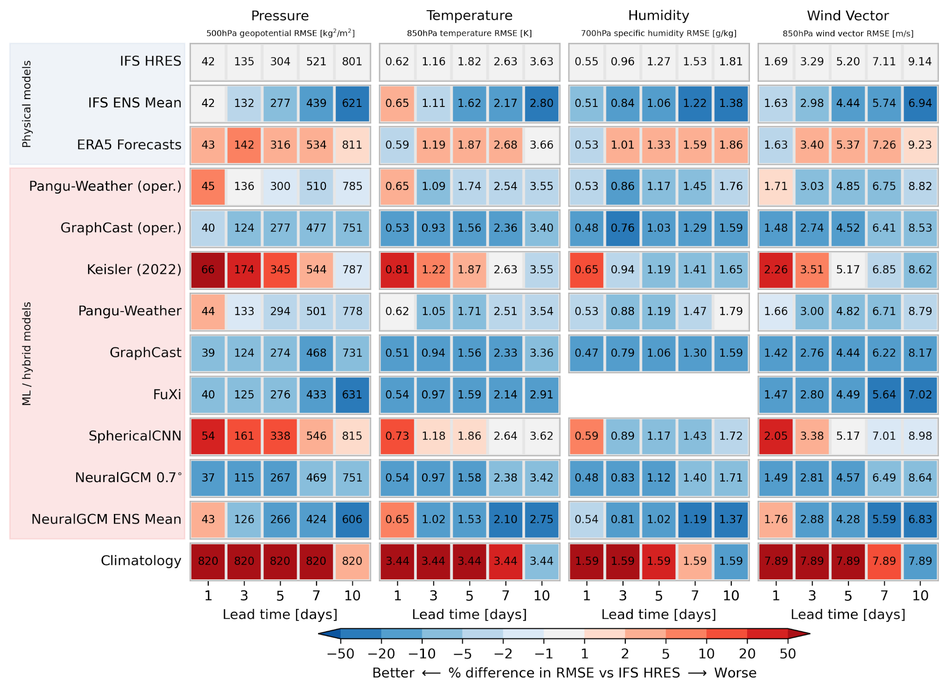
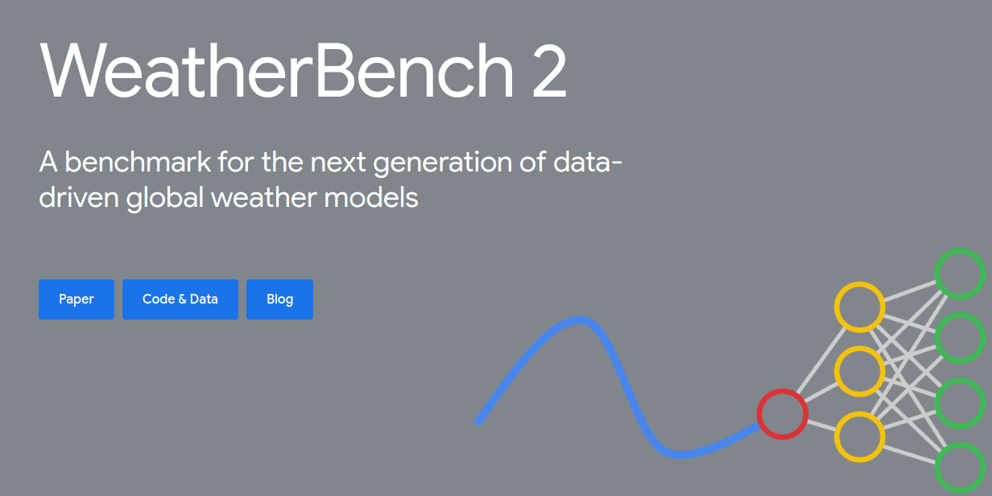
ML-based weather forecasting
IPSL
Now…

Slide 20
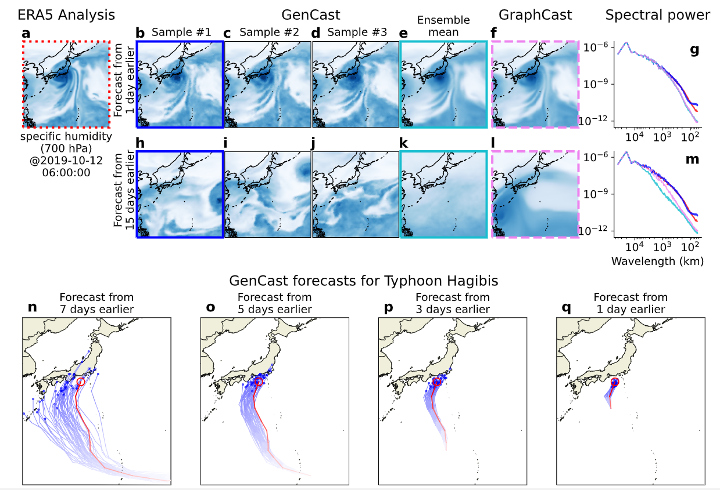
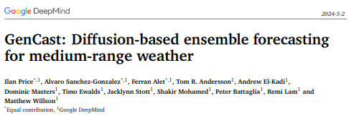
ML-based weather forecasting
IPSL
Towards beating the ENS model

Slide 21
Part IV
Conclusion
Notes:
why

Slide 22
Data scientist (personal) lessons
IPSL
In Climate/Weather science and in general
Machine Learning offers very powerful tools, you need to be careful when choosing the right one for your problem
It is crucial to incorporate as much domain expertise as you can in your Machine Learning projects
Patience and open mindedness is key when collaborating with machine learners
Techniques that combine physical knowledge and machine learning are increasingly popular
Climate/Weather scientists call for transparent AI: interpretable and explainable AI
As a data scientist you continuously learn: Stay updated with new tools, techniques, and real-world applications.

Slide 23
THANK YOU
Redouane Lguensat rlguensat@ipsl.fr
Website: redouanelg.github.io Bluesky: @redouanelg

